Slide 1
Is Pakistan Ready for Digital Revolution?
Name: Muhammad Taqui
Enroll# 01-136221-021

Slide 2
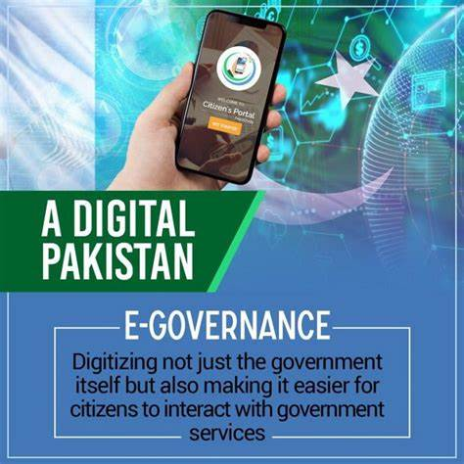
Role of PTI government
The subject of ‘digital Pakistan’ became the talk of the town when the PTI government embarked on the journey of digitalizing Pakistan under ‘Digital Pakistan Vision’ in December 2019. All the segments of the country have shown great enthusiasm for the initiative.

Slide 3
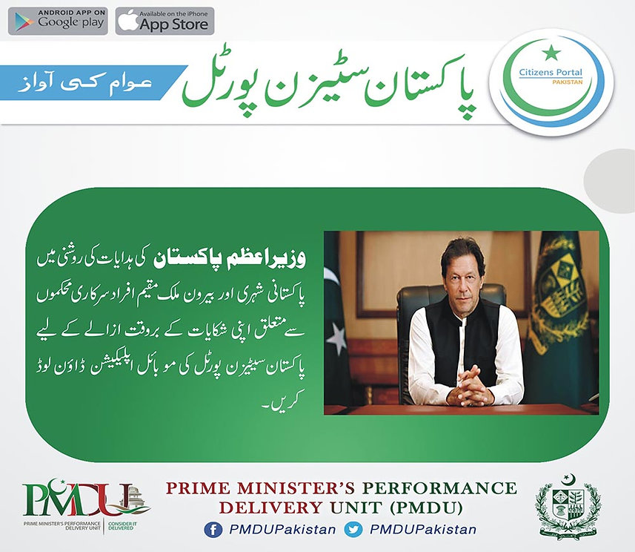
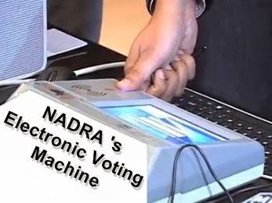
PTI’s Digital Policy
$2 billion set aside for National digital transformations & provision of different services to citizens through mobile.
Using technology to open government data to increase transparency.
Establishment of 120 new campuses to produce 100,000 technology graduates/year
A focus will be on creating enabling environment for start-ups and entrepreneurs.

Slide 4

Role of past Governments
The governments in the past never took any practical steps to digitalize Pakistan. However, the PTI government seems to be very clear in its vision and has an understanding of the hidden potentials associated with the full-scale infusion of technology in the country.

Slide 5
Is Pakistan Ready for Digital Revolution?
Freelancing
Illiteracy
Poverty
Weak Economy

Slide 6
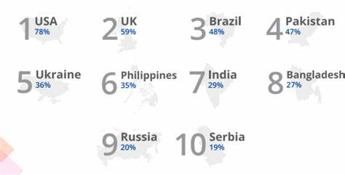
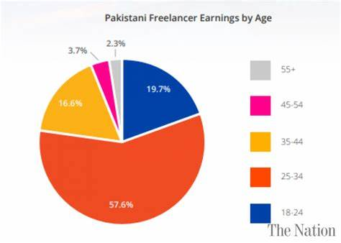
Freelancing
Pakistan ranked among top 5 freelancer markets. Pakistan has huge potential when it comes to freelance services considering that 70% of the total population is under the age of 30. In the recently published by Payoneer rankings for freelance markets, Pakistan has been ranked at 4th, well above India and Bangladesh.These stats are amazing for dream of digital Pakistan.

Slide 7
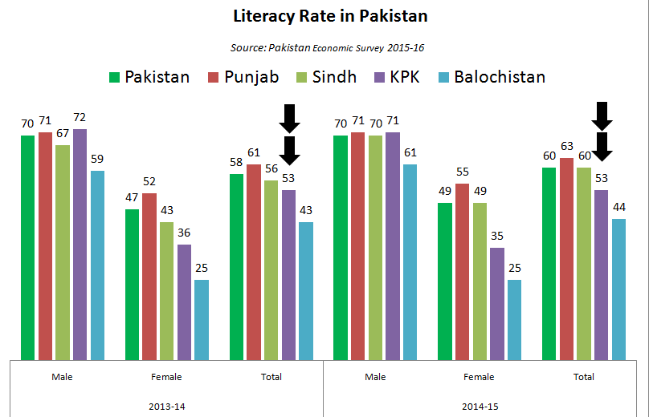
Illiteracy
A large chunk of the population, almost 42%, is illiterate. Pakistan’s youth literacy rate is 71%, which means 29% of youth are illiterate (Report). For such people, using Information and Communication Technology would be a challenge.

Slide 8
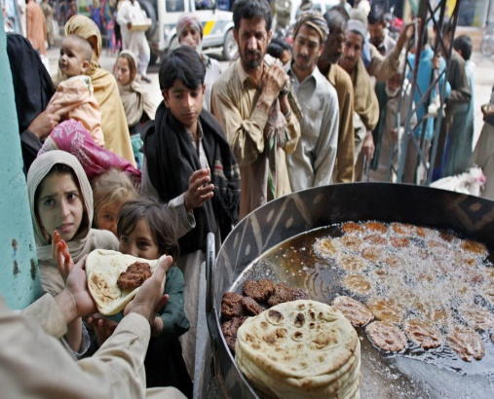
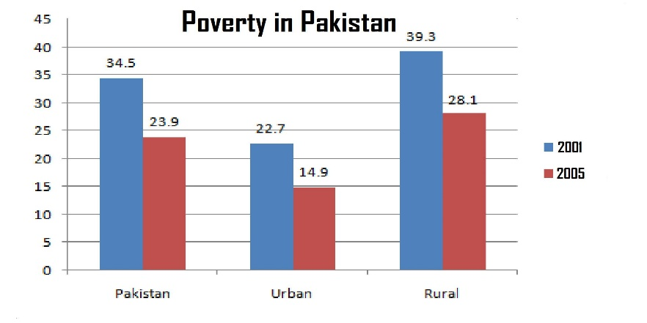
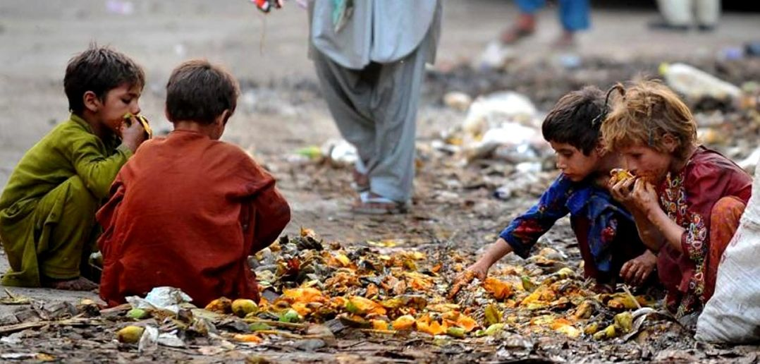
Poverty
As per the latest poverty estimates, 24% of Pakistan’s population lives below the poverty line; including 31% in rural areas and 13% in urban areas. Owing to poverty, most of the Pakistani population is unable to buy technological gadgets including smartphones, laptops, or internet facilities. In presence of such social constraints, technology, and digitalization in Pakistan would not bear the desired fruits.

Slide 9
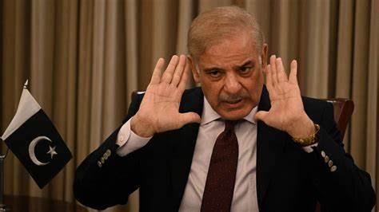
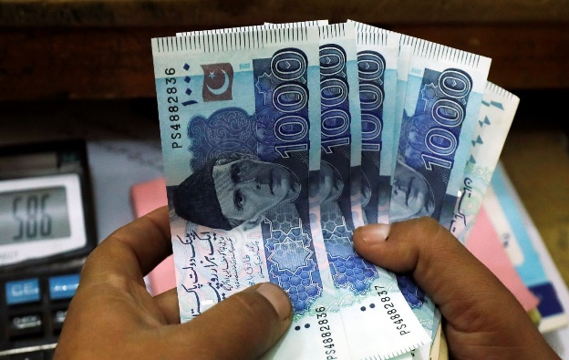
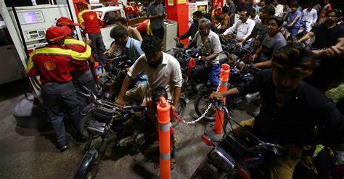
Weak Economy
For the dream of digitalized Pakistan to be materialized, the spread and availability of technological and digital knowledge is a mandatory precondition. Whereas, the government has allocated a mere 2.3% to the education sector in the year 2019-20, in terms of GDP. With such meager economic resources and budget allocation, digital and technological knowledge and skills cannot be imparted or made available to the masses.

Slide 10

Conclusion
Here, without writing any specific conclusion, I think it would be better to leave this topic open-ended for you.

